Slide 1
LARGE LANGUAGE MODELS HACKATHON: AI ALCHEMISTS

Slide 2


Team Name: AI ALCHEMISTS
TEAM LEAD
TECHNICAL INTERESTS
Data analysis
Automation
Software Development
Artificial Intelligence
Machine learning
NAME : Meenakshy N S
DEPT : Computer Science and Engineering
SEMESTER : 8
PROJECTS WORKED :
Interview Practice Website
Music and Book Recommender
Alternative Title Generator and Scanned Documents Handler
DATA/ML ENGINEER
NAME : Neeraja Krishnakumar
DEPT : Computer Science and Engineering
SEMESTER : 8
PROJECTS WORKED :
DocPotion 2024 (Document processing solution)
AI Chatbot for Interview Practice 2023,
Angel Fashion Trendz (A print on demand (POD) e-commerce prototype app)
TECHNICAL INTERESTS
Data Science
AI/ML
Cybersecurity
Cloud Technology
App Development
Backend Web Development

Slide 3

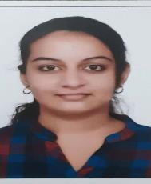
Team Name: AI ALCHEMISTS
SOFTWARE ENGINEER
NAME : Nandhana A R
DEPT : Computer Science and Engineering
SEMESTER : 8
PROJECTS WORKED :
Interview Practice Website -Developed a comprehensive Interview Practice Website featuring interactive quizzes to simulate interview scenarios and a sophisticated chatbot for conducting mock interviews
TECHNICAL INTERESTS
Web designing
Artificial intelligence
Data Science
Front End Development
Networking
Back End Development
DOCUMENTATION/PRESENTATION
TECHNICAL INTERESTS
Data Science
AI/ML
Neural Networks and Deep
Learning
Competitive Coding
NAME : A Ardra Nair
DEPT : Computer Science and Engineering
SEMESTER : 6
PROJECTS WORKED :
DocPotion 2024 (Document processing solution)
AI Referee Assistant(An alternative to existing VAR system in refereeing football matches)

Slide 4
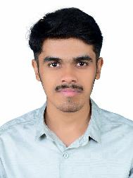
Team Name: AI ALCHEMISTS
DOCUMENTATION/PRESENTATION
NAME : Binil Babu P
DEPT : Computer Science and Engineering
SEMESTER : 4
PROJECTS WORKED :
DocPotion 2024 (Document processing solution)
TECHNICAL INTERESTS
Problem Solving
Frontend Development
AI/ML
Competitive Coding
FACULTY MENTOR:
DR RAMANI BHAI,
HOD,
DEPARTMENT OF COMPUTER SCIENCE AND ENGINEERING,
VIDYA ACADEMY OF SCIENCE AND TECHNOLOGY

Slide 5
LLM Problem Statement: Why
Large companies often have dedicated marketing teams and budgets, allowing them to create sophisticated marketing campaigns.
This gives them a significant advantage over Small and Medium-sized Enterprises (SMEs) who may have to rely on limited in-house resources or even forego marketing efforts altogether.
This lack of resources can severely hinder their ability to compete in the marketplace.
To address this challenge, we decided to build a product that can help SMEs identify their Strengths, Weaknesses, Opportunities, and Threats (SWOT).
By providing these crucial insights, our product empowers SMEs to compete more effectively, even with limited resources.

Slide 6
LLM Business Problem: What
Small and medium-sized enterprises (SMEs) often face challenges in marketing their products due to limited resources and expertise.
To address this problem, we propose a product that extracts customer feedback from the SME's and competitor's Flipkart websites.
Following this, we identify the strengths and weaknesses for both. Swot analysis for the SME is done by taking the competitor's strengths and weaknesses as their threats and opportunities, respectively. Thereby they can optimize their marketing strategies accordingly.

Slide 7
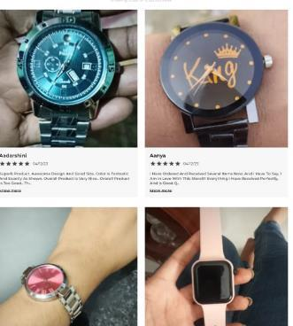
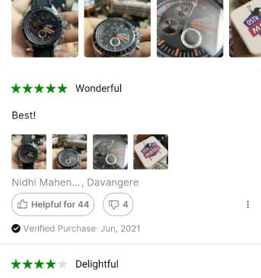
Solution Overview: How
“ELEVATEBIZ”
-The Elevator for your business!
Through our product, we empower SMEs to correctly interpret their strengths and weaknesses by conducting a comparative analysis of their competitors' features.
A rigorous SWOT analysis is carried out to help curate the perfect marketing strategy and unlock their full profit potential.
Reviews of Blue Pearl ‘s products
Credits:https://bluepearlwatches.in/
Reviews of a Fossil watch
Credits: Flipkart

Slide 8
Solution Overview: How
CUSTOMER FEEDBACK
WEBSCRAPING
DATAFRAMES
SENTIMENT ANALYSIS
CATEGORISED AS POSITIVE AND NEGATIVE
FEATURE EXTRACTION AND CLASSIFICATION
SWOT ANALYSIS
Initially we extract customer feedback from Client website(https://bluepearlwatches.in/)
Similar web scraping is carried out in the Flipkart review section of the competitors’ products.
Hugging Face models are now incorporated to process data collected and classify them into positive and negative sentiments
This is followed by feature extraction.
The data is then matched to labels using zero-shot classification
TEXT GENERATION
PRODUCT DESCRIPTION
WEB SCRAPPING
KEY INFORMATIONS
GPT-2

Slide 9
Solution Overview: How
SUMMARY
Identification of SME :- Blue Pearl Watches
Problem Identification :- Resources and expertise for marketing is what these SME lack in terms of marketing.
Technology Stack :- Selenium, Hugging Face, React
Open AI Supports :- GPT-2

Slide 10
Economic Logic
Automated & Efficient: Automates customer feedback analysis, saving time and resources compared to manual processes.
Reduced Costs: Minimize marketing expenses by optimizing strategies based on data-driven insights.
Customizable: Tailor the script for different e-commerce platforms by adjusting the selectors, processing logic, and classification labels based on the website
Return on Investment (ROI):
-Improvements in marketing effectiveness and customer satisfaction are expected to translate into increased sales and profitability, generating a positive ROI over time.
-Develop effective marketing campaigns that capitalize on the SME's strengths and address identified weaknesses.

Slide 11
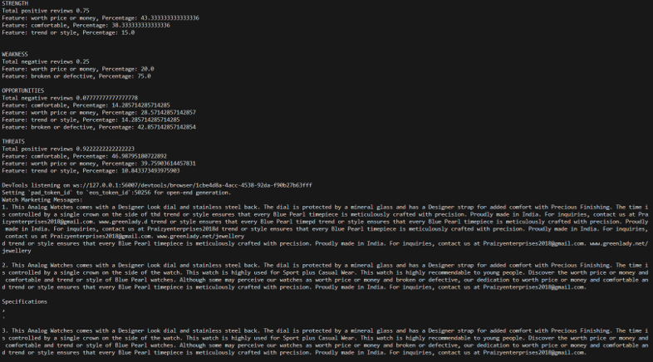
Project Demo

Slide 12
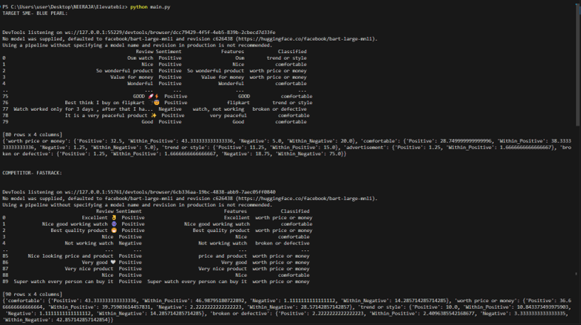
Project Demo

Slide 13
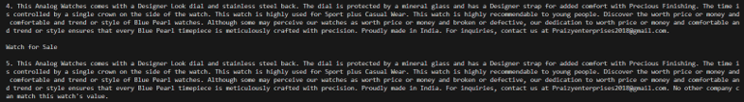
Project Demo

Slide 14
Why Our Product?
Streamlined Efficiency: Our product automates the entire process of web scraping and SWOT analysis, saving valuable time and resources for SMEs.
Cost Efficiency: By eliminating the need for manual labor and expensive software, our product offers cost-effective solutions tailored for SME budgets.
Universal Compatibility: Our product seamlessly operates across various websites, ensuring comprehensive market analysis regardless of platform.

Slide 15
Product Promotion Plan
Online Emphasis: Our marketing strategy prioritizes online channels, harnessing digital platforms for widespread exposure and engagement.
Geographic Rollout: Beginning with a focused approach in a specific geographical area, we aim to strategically penetrate local markets before scaling to broader regions.
Community Engagement: Active involvement in local events such as fairs and industry gatherings will enable us to connect directly with SMEs, fostering brand awareness and trust within the community.

Slide 16
FUTURE SCOPE
Enhanced SWOT Analysis: With more access to in-depth data of the SME company, we can provide a more accurate and comprehensive SWOT analysis.
Accuracy Assessment: By leveraging more customer feedback and observing sales, we can accurately measure the effectiveness and reliability of our product.
Improved Marketing Strategy: With access to more data and knowledge of current market trends, we can offer a better-tailored marketing strategy to SMEs.
Automated Strategy Generation: With human involvement, we can develop a system that generates marketing strategies based on internal data and competitor analysis, optimizing marketing efforts.

Slide 17
PRICING OPTIONS
Empowering SMEs is at the heart of our mission.
Our pricing options reflect our commitment to flexibility and accessibility, ensuring every SME can benefit from our product's innovative solutions.
Basic Plan: Initial access to the basic product for SMEs, followed by paid plans determined by profit attained.
Premium Plan: Priced from the start, includes extra features outlined in the future scope for enhanced functionality and performance.

